Slide 1
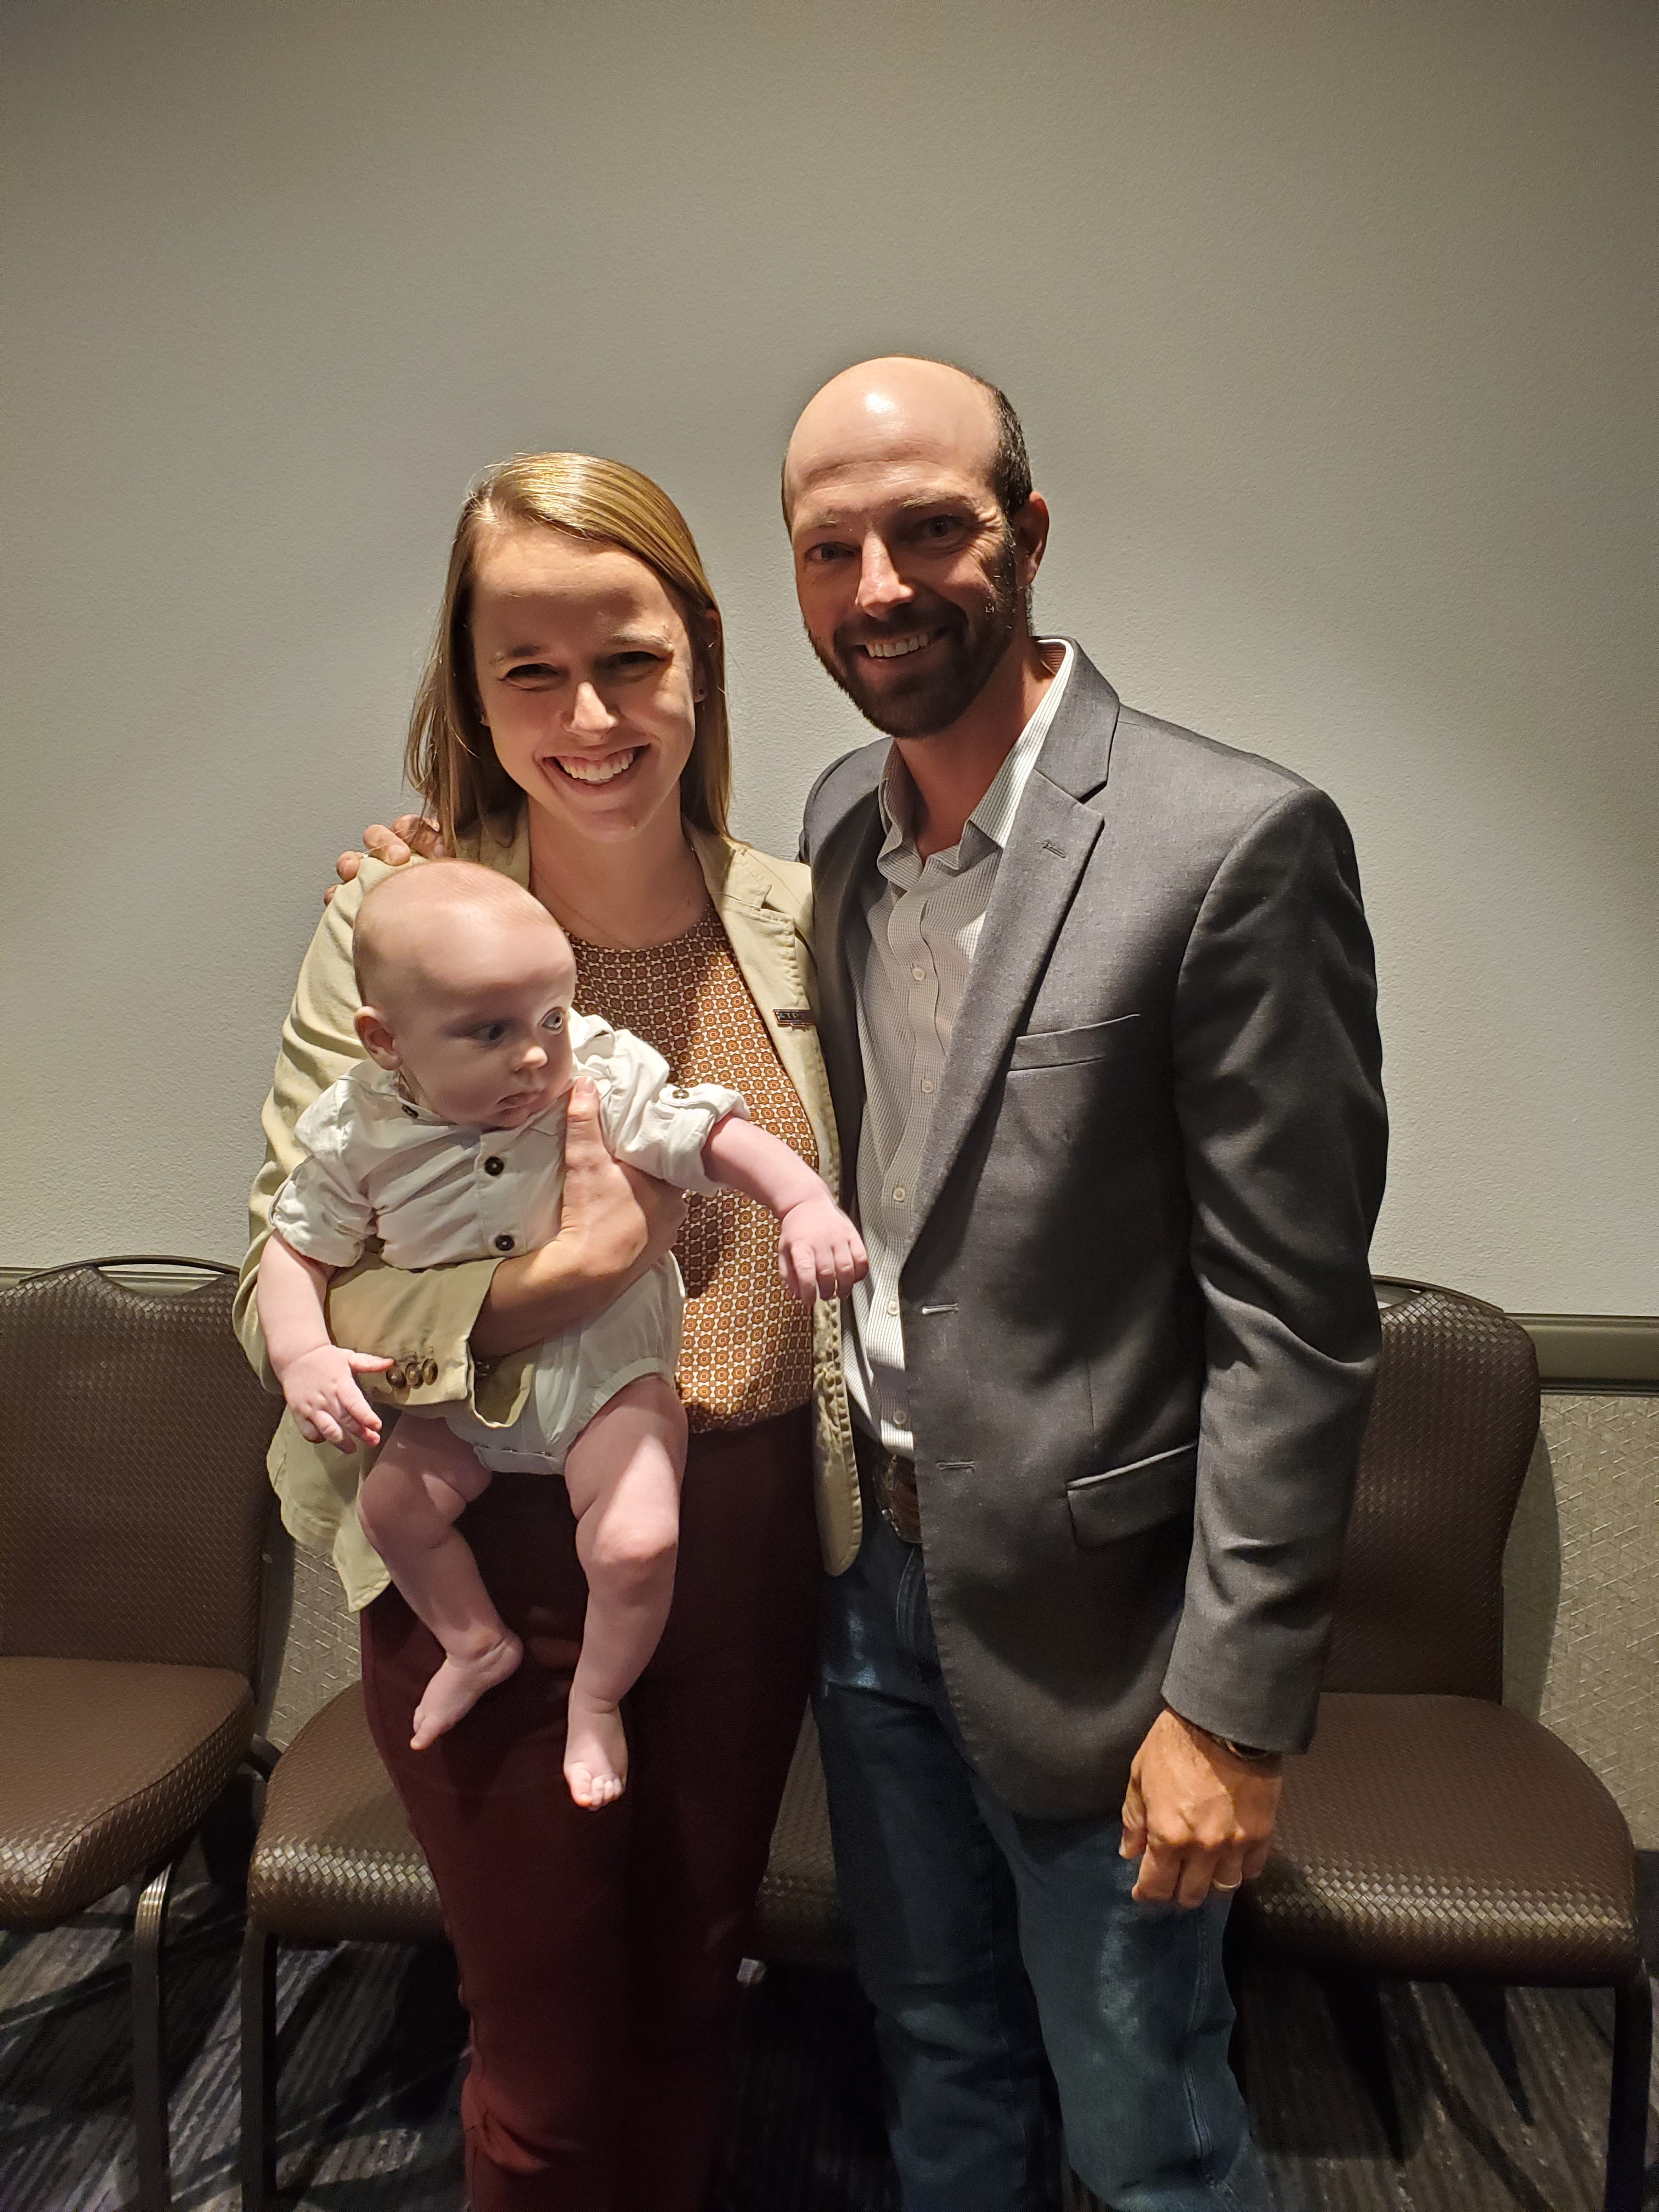
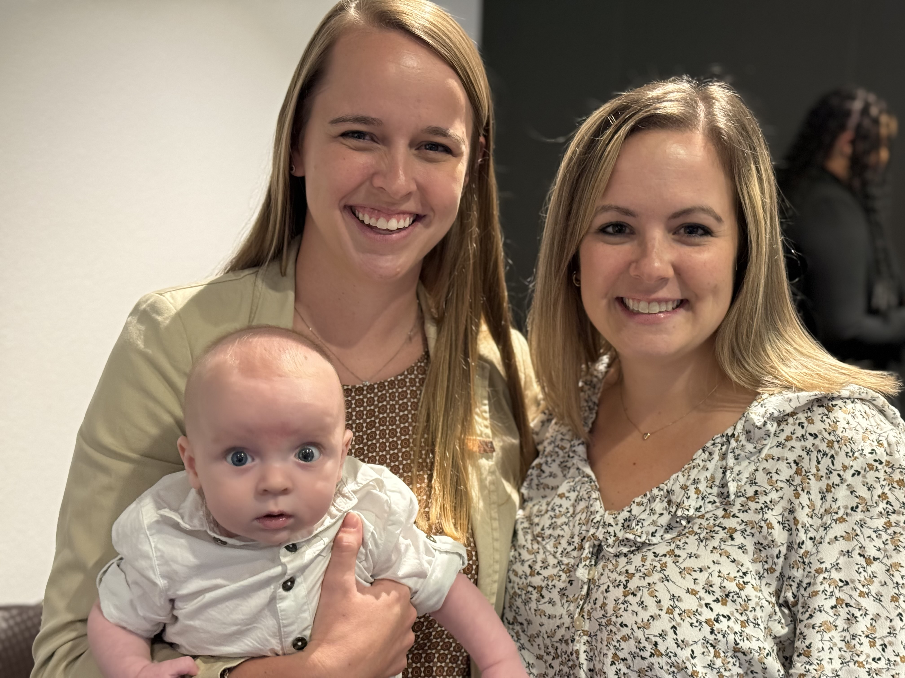
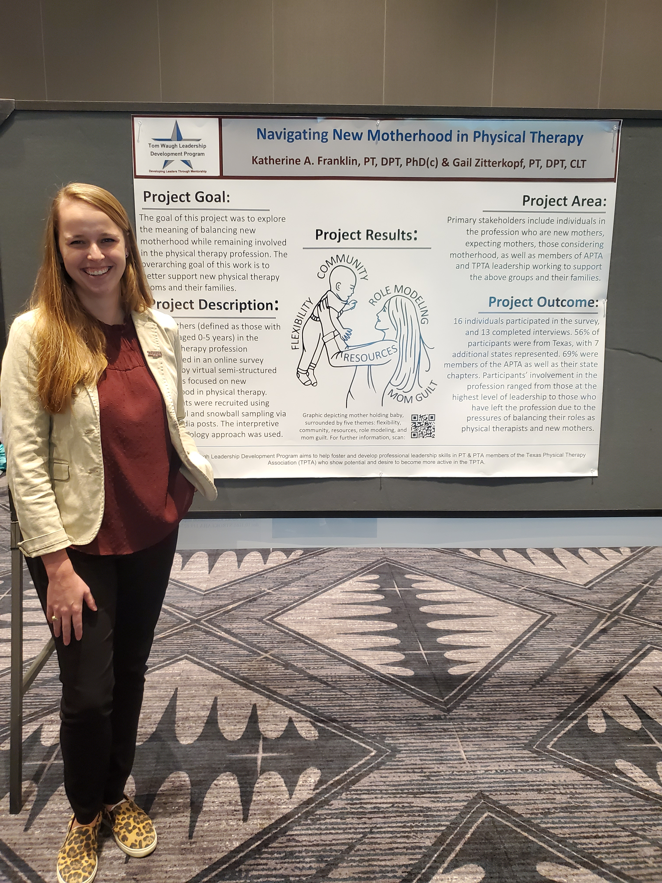
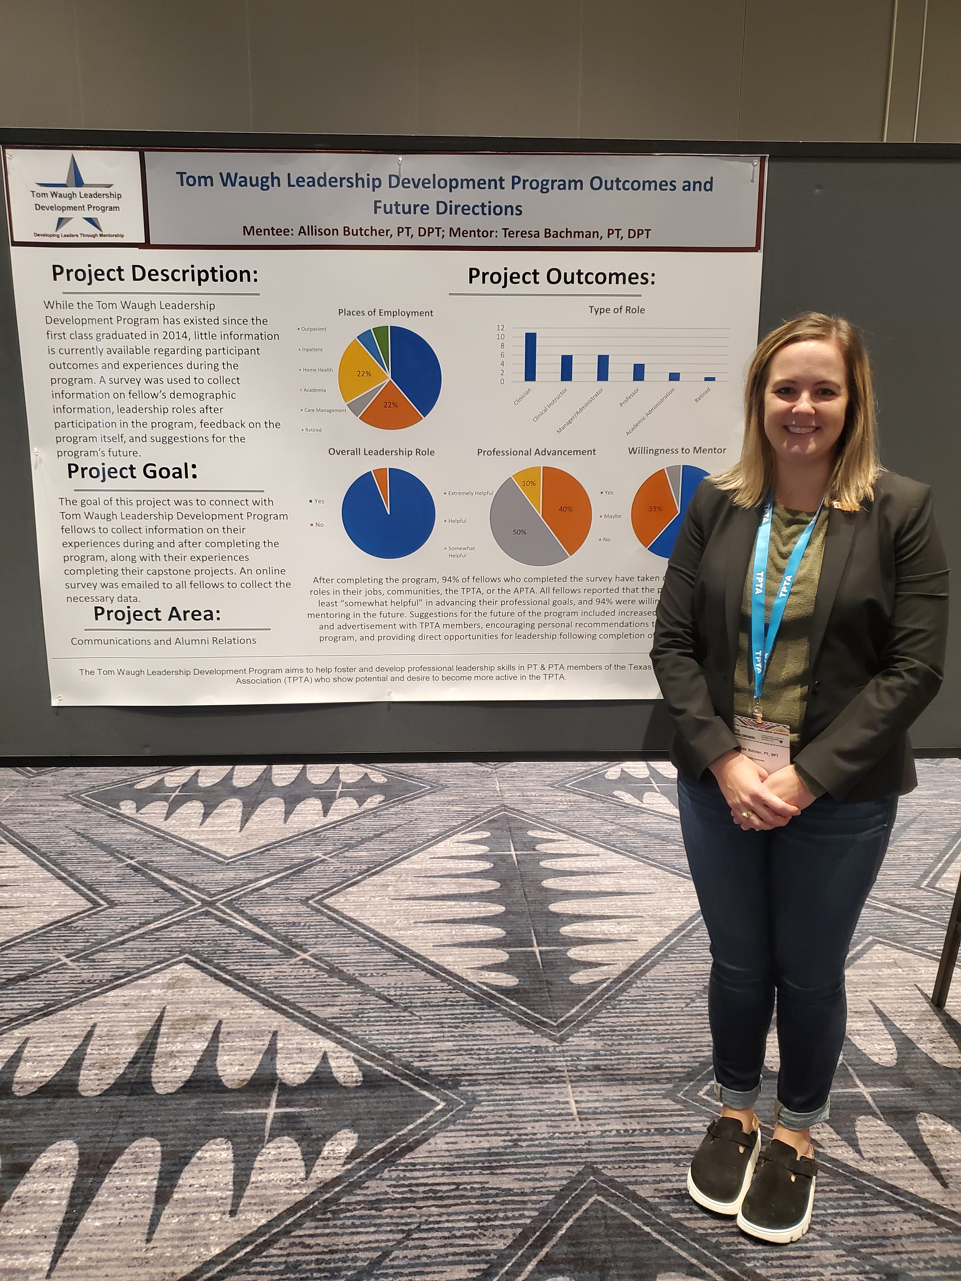
Tom Waugh Leadership Development Program Fellowship Awards Ceremony
Celebrating 10 years!!
October 27, 2023
Kalahari Resort Conference Center, Round Rock, TX

Slide 2
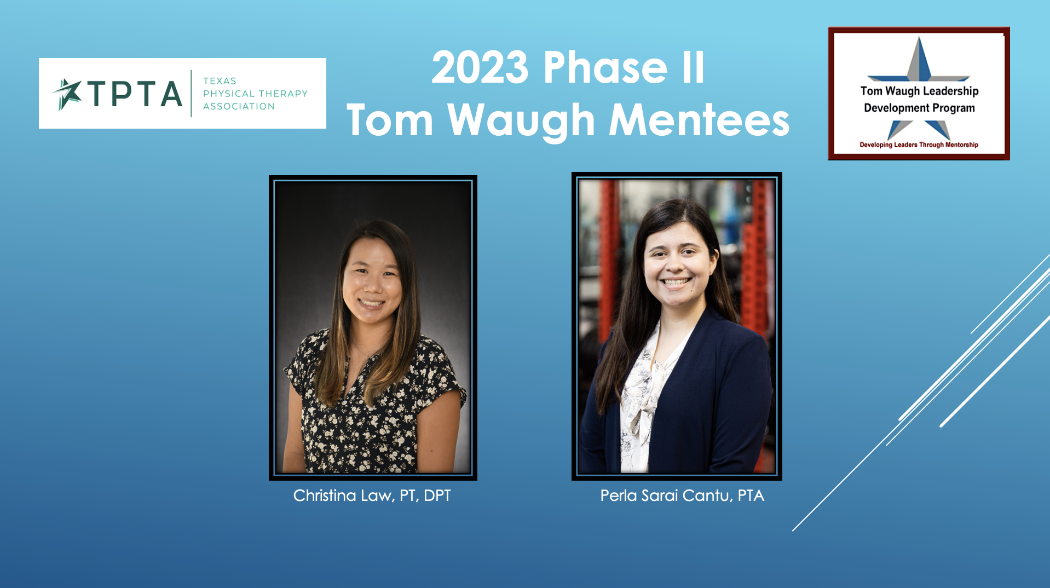
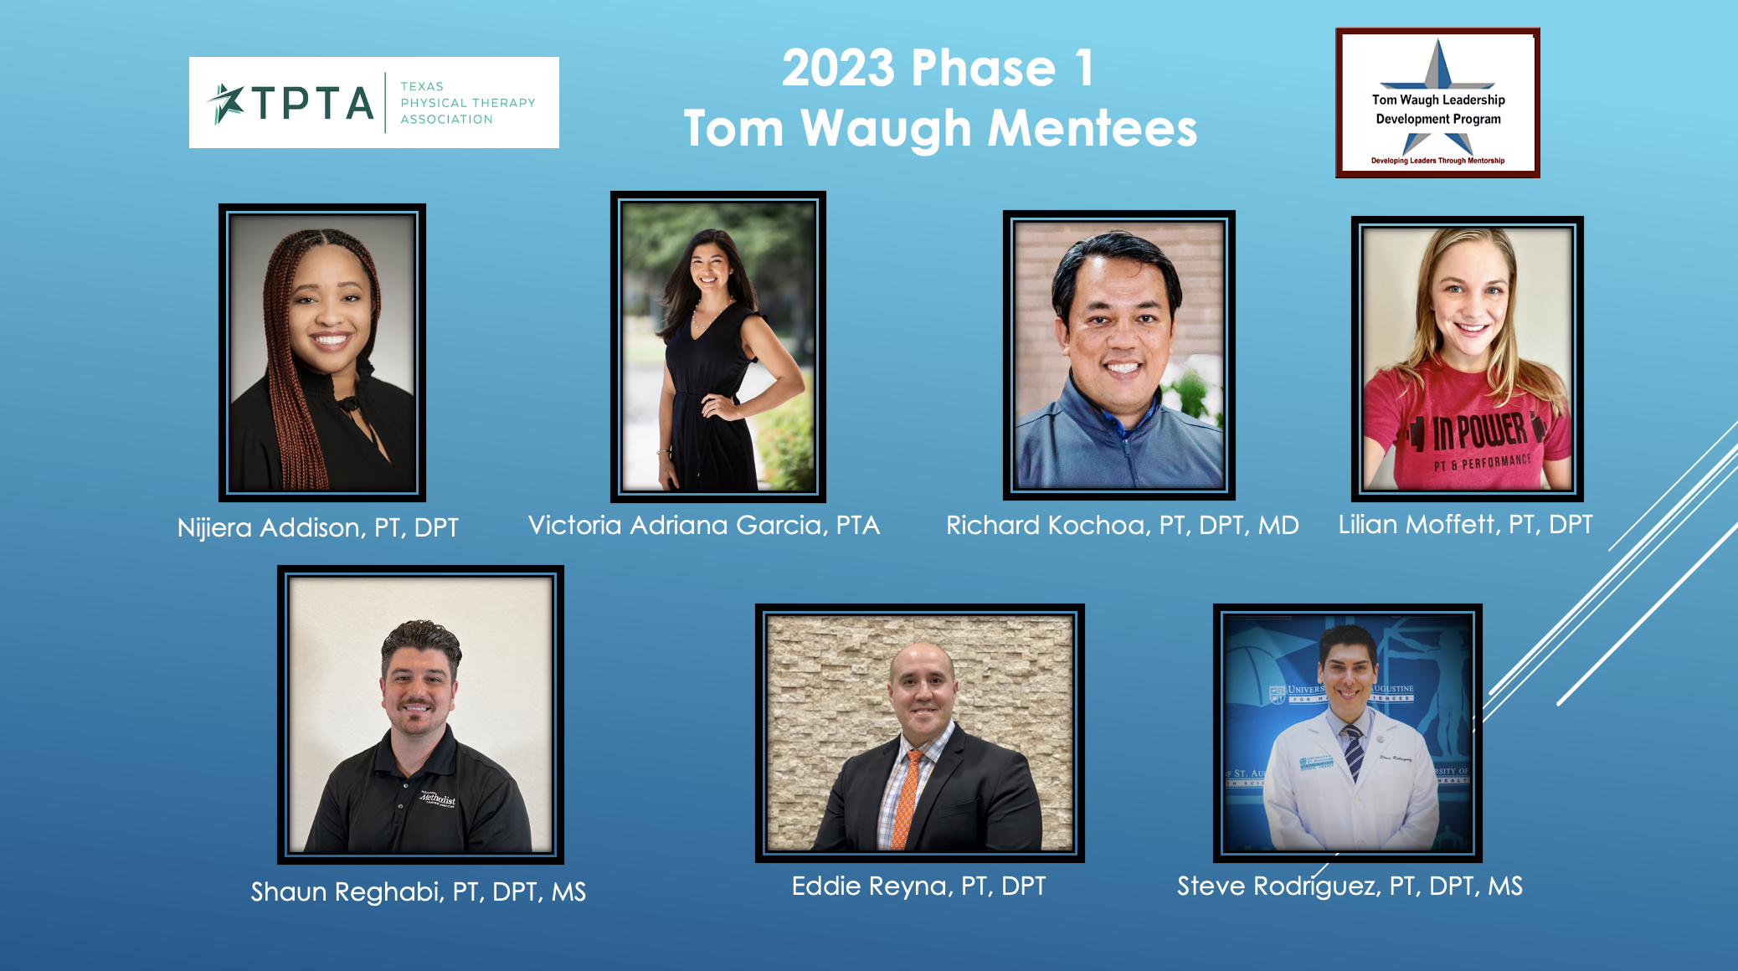
Tom Waugh Leadership Development Program Fellowship Awards Ceremony
Celebrating 10 years!!
October 27, 2023
Kalahari Resort Conference Center, Round Rock, TX

